Slide 1
Nutrition for Families
Susie Schneider, RD

Slide 2
Objectives
Explore basic nutrition guidelines from infancy – adolescents
Discuss various topics for introducing food to little ones including choking hazards, allergies and picking eating
Components of a balanced snack and meal
Bone building nutrients
Research on artificial colors and sweeteners
Discuss eating disorders and how to talk to kids about food

Slide 3
Nutrition for Infants
Breast milk, infant formula or a combination of the two provides a complete source of energy and nutrients needed for normal growth and development
Choose what works best for you and your family!
Breast milk and/or formula should be the only source of nutrition for the first 6 months of life
Supplements if given breast milk
  vitamin D should be given daily soon after birth (10 mcg or 400 IU)
  Iron may need to be given before 6 months
  Ask your pediatrician what supplements your baby needs!

Slide 4
Solid foods for infants
Most babies are ready to start eating solid foods around age 6 months
  Sit unassisted and hold their head up
  Try to grab objects and bring them to their mouth
  Reaching for caregiver’s food
If you’re not sure if your baby is ready, check with their pediatrician
While introducing foods, keep giving your baby breast milk or infant formula. Until age 1, infant formula or breast milk is still their primary source of nutrition.
If you’re using infant formula, stop giving formula at age 12 months
If you’re giving your baby breast milk, continue as long as you want
Aim for serving 3 meals/day by 9 month old so they get adequate practice with solid food before 1 year old

Slide 5

Feeding methods for infants
Baby-led weaning
Purees / traditional weaning
Whole foods starting for their first bite
Baby picks up and eats foods by themselves
One thing to keep in mind is that parents often confuse choking and gagging. Understanding the difference is important if you hare considering the baby led weaning method of feeding.
Food is introduced in a puree form and the texture progresses over time
Typically requires the parent/caregiver to spoon feed the baby when the puree is thin
One of the most important things with this method is that you are introducing textured food to your baby at the right times so they learn how to move chunkier foods around in their mouth.

Slide 6
Choking hazards
Gagging and choking are not the same thing! Gagging involves sound, which means your baby is still breathing.
In general, foods are considered choking hazards when they are
  Very hard: popcorn, whole nuts, raw carrots
  Very round and slippery: the shape and smoothness of a grape or cherry
  Very sticky or difficult to chew: taffy, gum, gummy bears
Safety tips
  Do not allow your child to crawl or walk around while eating
  Keep snacks out of the car unless an adult is in the backseat
  Always supervise children when eating
  Ensure your child is sitting upright when eating
  Arm yourself and caregivers with resuscitation and CPR skills
Notes:
This list references the American Academy of Pediatrics, the Center for disease and control prevention, the AND and emergency room choking data

Slide 7
Foods that must be modified
Hot dogs: cut into small pieces
Whole nuts: offer as thinly spread nut butter or as ground nuts
Whole grapes, cherries or cherry tomatoes: cut into quarters lengthwise
Large hard carrots or celery: soften by cooking, grate or finely cut
Whole apples: soften by cooking, grate or finely cut
Hard dried fruit: soften by cooking (put in oatmeal, baked goods)
Whole olives: cut into quarters
Marshmallows: bake into foods
Large chunks of hard meat or hard cheese: cut into smaller pieces

Slide 8
Foods that should be avoided until age 4
Whole large seeds
Popcorn
Hard candy
Gummy bear candy
Sticky candy (taffy, fruit leather)
Gum
Hard chips (potato chips, tortilla chips)

Slide 9
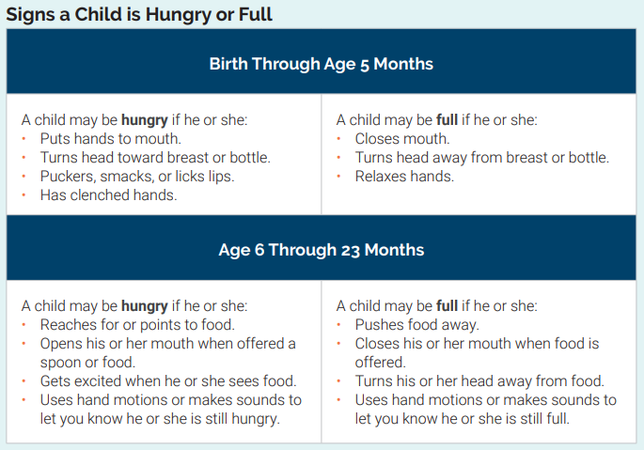
Honor your baby’s hunger cues
Responsive feeding: a feeding style that emphasizes recognizing and responding to the hunger or fullness cues of an infant or young child
Helps young children learn how to self regulate their intake

Slide 10
Allergenic foods
Allergenic foods should be offered around 6 months
  Peanut butter
  Tree nut butter
  Wheat
  Dairy
  Shellfish
  Finned fish
  Sesame
  Egg
  Soy
In 2015, a groundbreaking study demonstrated that the early introduction of peanuts to at-risk babies could reduce the risk of developing peanut allergy by as much as 81%. In other words, delaying the introduction of peanut could actually increase the likelihood of peanut allergies developing.
Introduce one new allergenic food at a time. Continue to offer allergens frequently as your baby gets older to help reduce their allergy risk
Reactions can happen up to 2 hours after ingesting food and do not always happen at the first exposure

Slide 11
Offer a variety of foods
Vegetables: like avocado, cooked carrots, baked sweet potato, green beans, steamed broccoli
Fruits: like banana, strawberries, pears and melons
Whole grains: like brown rice, quinoa, oatmeal and whole grain bread
Protein foods: like salmon, chicken, beef, egg, thinly spread nut butter, beans and lentils
Dairy: like whole milk, full fat yogurt and full fat cheese

Slide 12
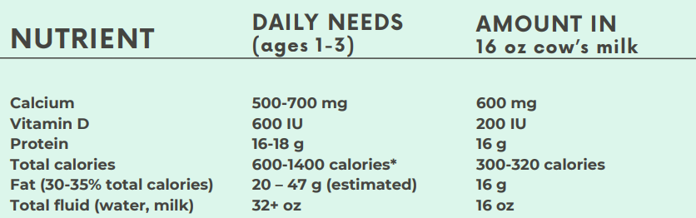
Nutrition for Toddlers
Below is a chart showing the estimated nutrient needs of toddlers compared to 16 oz whole milk
If your child drinks more than 3 cups of milk they may be fulfilling a good portions of the calorie needs through milk and not have much of an appetite for other foods

Slide 13
Nutrition for toddlers
In the first two years of life, fat is critical for brain development. You should choose whole fat dairy during this age
After age 2, kids should shift to low fat/fat free dairy products according to USDA Dietary Guidelines for Americans, American Heart Association and American Academy of Pediatrics
Stay away from feeding your little one sugar sweetened dairy like a lot of the kids yogurts out there!

Slide 14
What about picky eaters
Picky eating is very common in young kids, even if they seem to eat everything when they were just under a year old! Don’t be discouraged.
  Offer foods MANY times! Kids may need exposure to a food up to 20 times before they actually try it!
  At meal time, always put a “safe” food on the plate
  Offer foods from all five foods groups each day to encourage eating a variety of foods
    Fruits, vegetables, grains, protein foods and dairy/fortified milk alternatives
  Serve foods in small portions at meal and snack times
  Offer choices such as “do you want broccoli or cauliflower with dinner” instead of “do you want broccoli with dinner”
  Toddlers can fill up on drinks so offer water between meals

Slide 15
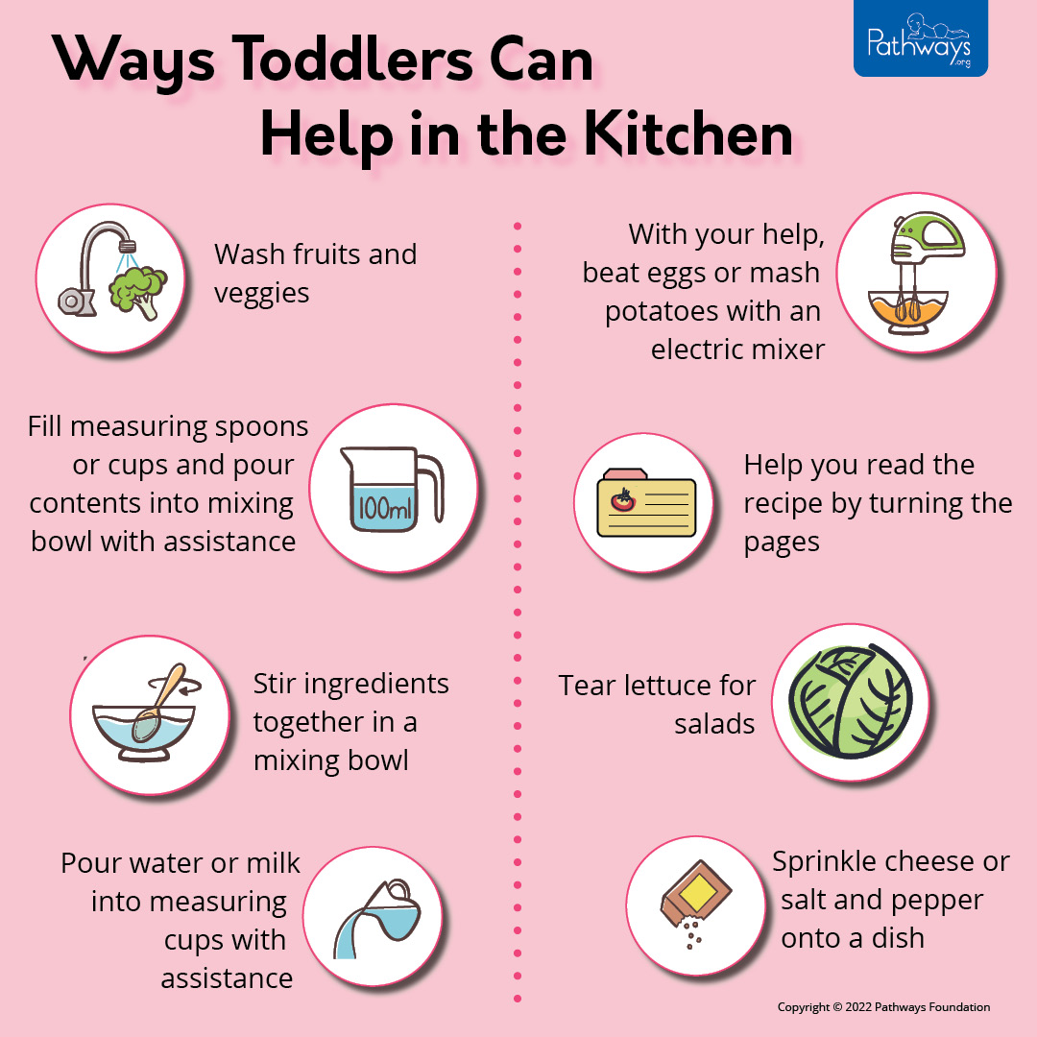
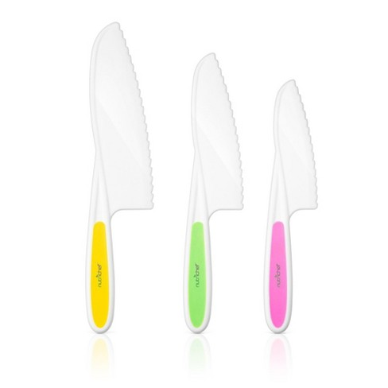
Get kids involved in the kitchen
Name a food your child helped create and make a big deal out of serving “Peter’s sweet potatoes” or “Sammy’s salad”

Slide 16
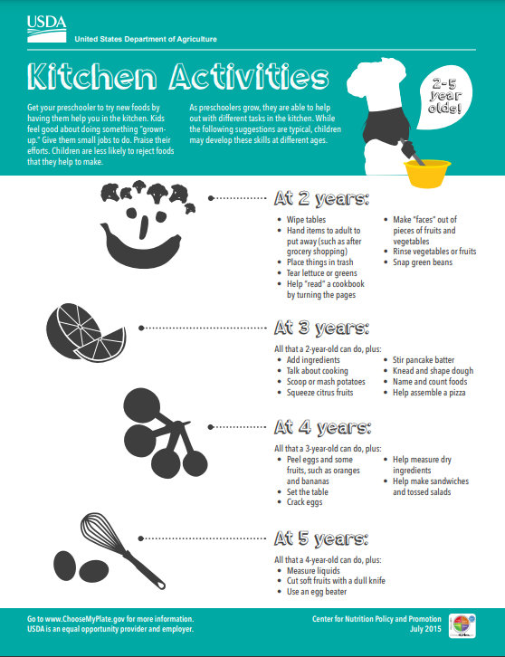

Slide 17
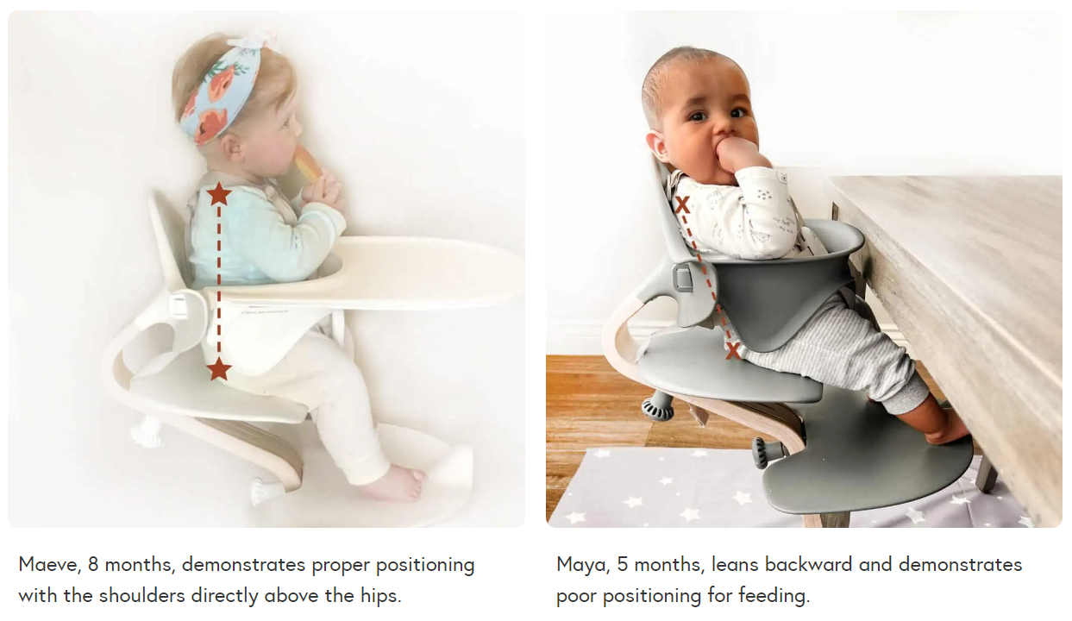
Four foundations of meal time
1. Eat with your children as often as possible
2. Turn off screens during meals
3. Ensure proper position, especially for infants
  Safe seating in a high chair includes
    Ability for a baby to sit upright
    Ability for baby to reach the tray (butt high enough in seat)
    Ability for baby to sit straight and in the middle of the seat
    Ability to safely reach the footrest
4. Prep for a mess!

Slide 18
Dietary patterns childhood – adolescent
The Dietary Guidelines for Americans was first published in 1980. It is updated at least every 5 years. The US Department of Agriculture and Health and Human Services must jointly publish a report containing nutrition and dietary information guidelines for the publish.
  https://www.dietaryguidelines.gov/sites/default/files/2020-12/Dietary_Guidelines_for_Americans_2020-2025.pdf
Guideline 1: follow a healthy dietary pattern at every life stage
Guideline 2: customize and enjoy food and beverage choices to reflect personal preferences, cultural traditions and budgetary considerations
Guideline 3: focus on meeting food group needs with nutrient dense foods and beverages and stay within calorie limits
Guideline 4: limit foods and beverages higher in added sugars, saturated fat, and sodium, and limit alcoholic beverages

Slide 19
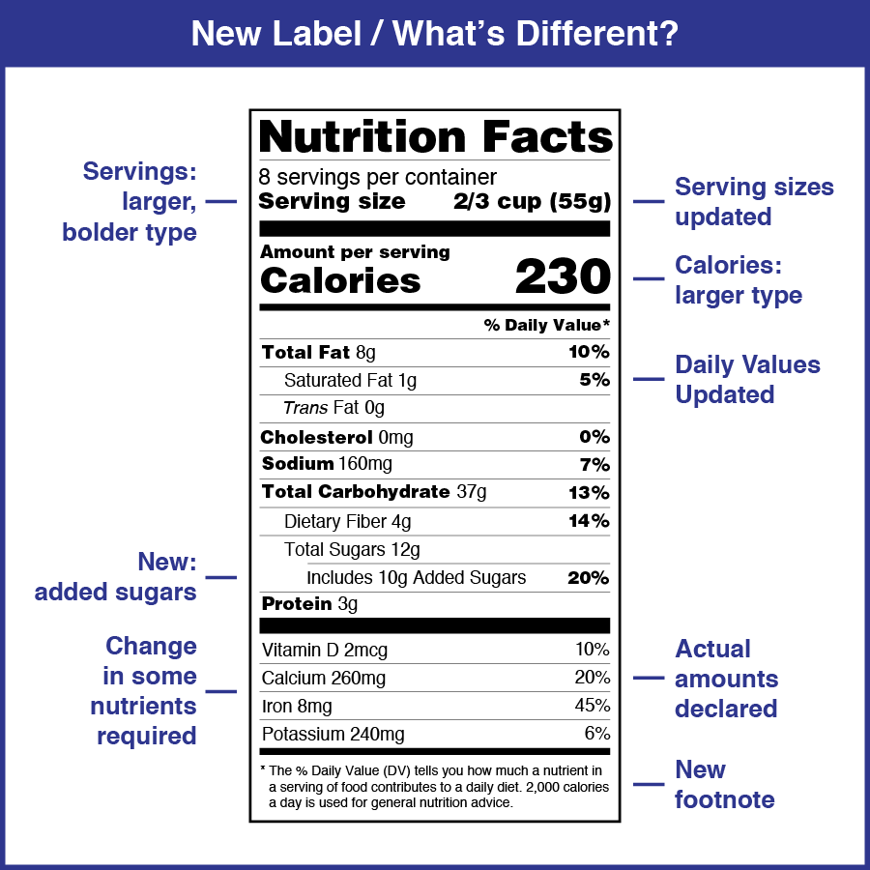
Dietary guideline 4: added sugar, saturated fat and sodium
Added sugar
  Less than 10% of calories per day starting at age 2
  Avoid foods and beverages with added sugar for those younger than age 2
Saturated fat
  Less than 10% of calories per day starting at age 2
Sodium
  Less than 2,300 mg per day (and even less for children younger than age 14)

Slide 20
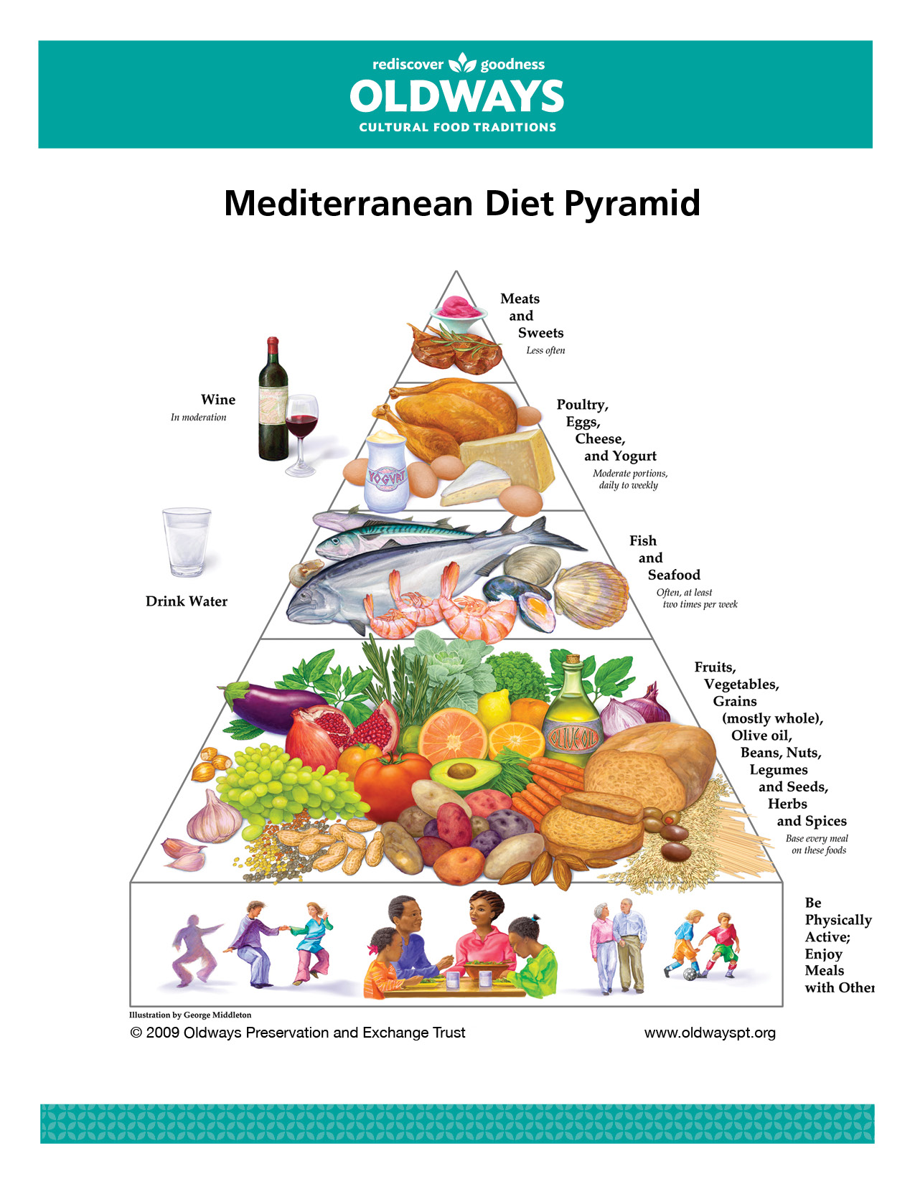
Healthy Lifestyle and Habits
Mediterranean diet is a great overall lifestyle!
It emphasizes vegetables, fruits, whole grains, beans and legumes
Includes low-fat/fat free dairy products, fish, poultry, non-tropical vegetable oils and nuts
Limits added sugars, sugary beverages, sodium, highly processed foods, refined carbohydrates, saturated fats and fatty or processed meats

Slide 21
Healthy Bones
Childhood and adulthood are the bone building years
17% of women and 5% of men have are diagnosed with osteoporosis
As children grow, their bone mass increases until it reaches what is called peak bone mass (PBM)
PBM is the greatest amount of bone an individual can attain and is reached in the late teens and early 20s
It is important for kids and teens to get enough calcium and vitamin D to build healthy bones
  Low fat or fat free milk and yogurt
  Low-fat cheeses
  Unsweetened fortified milk alternatives

Slide 22



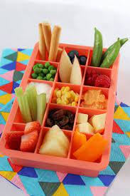
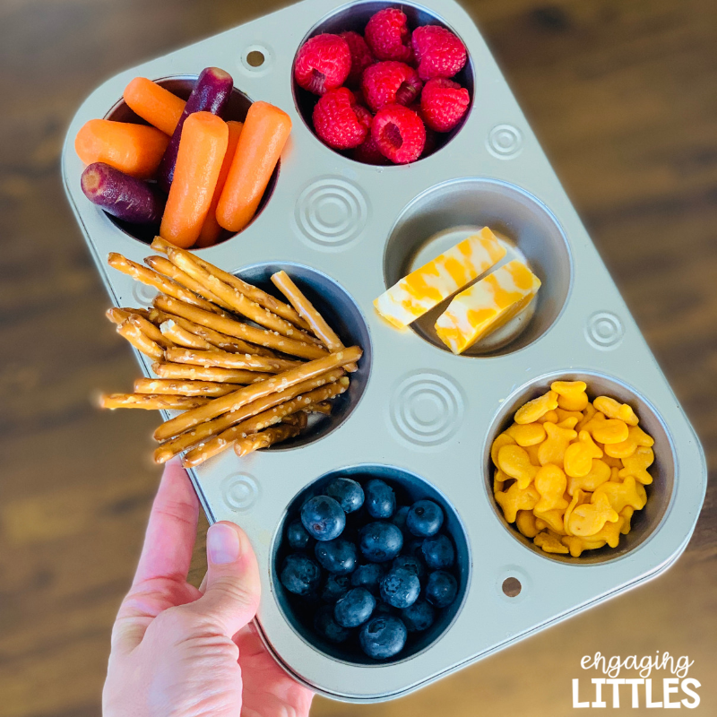
Healthy Snack Composition
Protein + Fiber
  Cheese stick and apple
  Peanut butter and celery
  Hummus and whole grain cracker
  Greek yogurt and berries
  Boiled egg and banana
  Roasted chickpeas
  Mixed nuts
  Nut based bar (such as a Larabar)

Slide 23
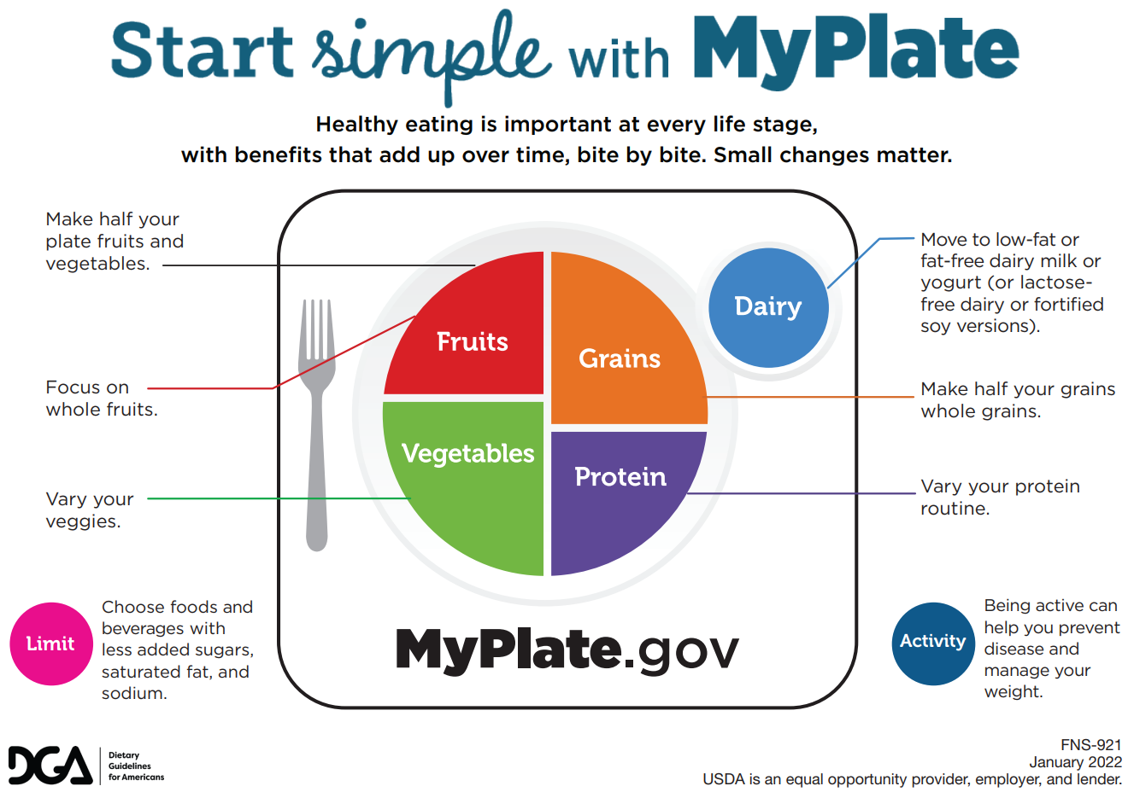

Slide 24
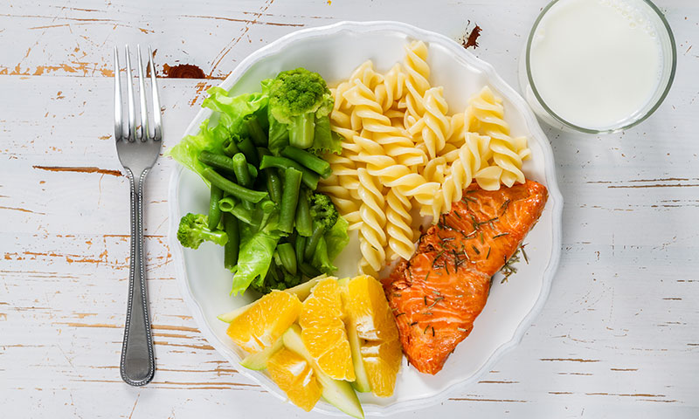

Slide 25
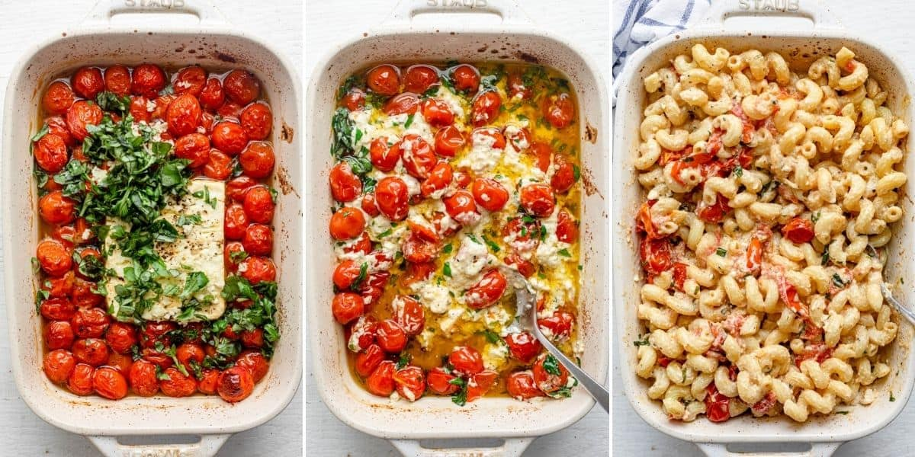
Baked feta with roasted veggies and pasta

Slide 26
Artificial Colors
The following artificial food colors are allowed according to the FDA
  Artificial colors, Red #3, Red #40, Yellow #5, Yellow #6, Blue#1, Blue #2, Green #3,Orange B, Citrus Red #2
“USDA organic” does not allow any artificial dyes
Red Dye 40
  One of the most popular color additives
  A man made synthetic food coloring that is a petroleum based dye, sourced from crude oil
  Banned in Europe
  Potential side effects may include: hyperactivity (including ADHD), behavioral changes like irritability and depression, allergic reaction, hives and asthma, sneezing, watery eyes, skin irritation, migraines
  Other names for Red Dye 40: Red 40, Red 40 Lake, FD&C Red No. 40, FD&C Red No. 40 Aluminum Lake

Slide 27
Foods that commonly include Red Dye 40
Cakes and frosting
Pastries
Cereals
Candy and gum
Yogurt
Puddings
Gelatins
Ice cream
Popsicles
Soda
Sports drinks
Energy drinks
Protein powders
Chips and salty snack foods
Liquid cough syrups and chewable tablets

Slide 28
Food dye alternatives
When cooking or baking consider using these ingredients to color your food!
  Beet juice
  Beet powder
  Blueberry juice
  Pomegranate juice
  Beta carotene
  Cranberries
  Cherries
  Strawberries

Slide 29
Dye Free Snacks
Annie’s organic variety pack
Strawberry, apricot and wildberry fruit strips variety pack
Fritos original corn chips
SkinnyPop microwave popcorn
Simply doritos and cheetos
Junkless chewy granola bars
Happy baby organics yogis freezer dried yogurt and fruit snacks
Bare baked banana/apple chips
Babybell mini original semisoft cheese
BEAR real fruit yoyos variety pack
Black forest gummy worms
Sunchips multigrain chips
Genexa kids honey cough syrup (don’t use under 1)

Slide 30
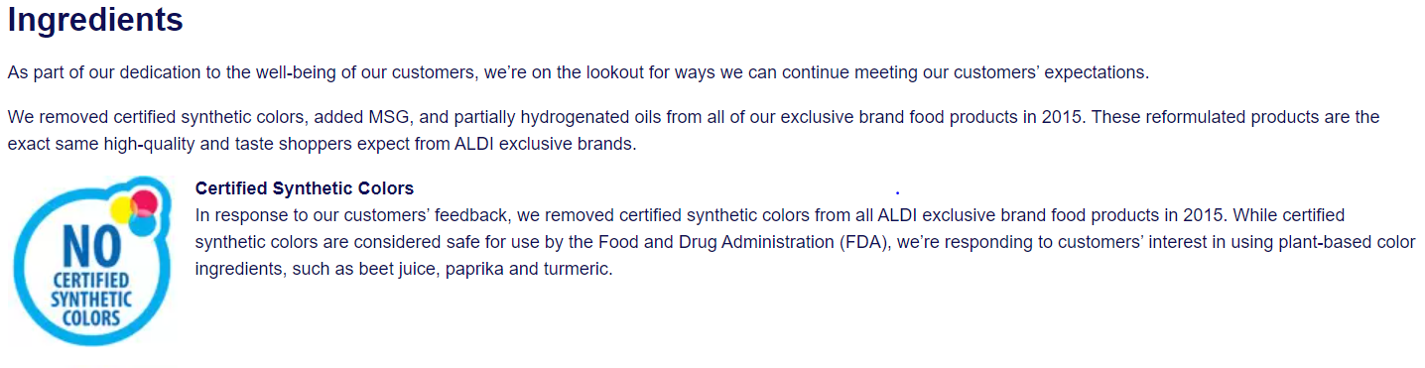


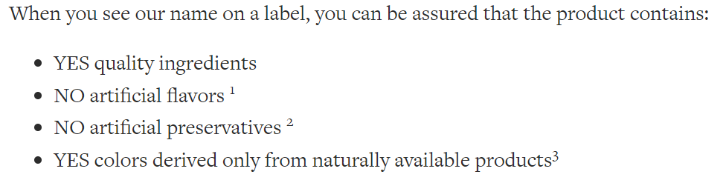

Slide 31
Artificial sweeteners
Artificial sweeteners are chemically synthesized substances that are used instead of sucrose (table sugar) to sweeten beverages and food
The caloric content of sweeteners used in such tiny amount is negligible, which is why they are often described as “nonnutritive”
6 artificial sweeteners are approved by the US Food and Drug Administration (FDA) as food additives
  Saccharin
  Aspartame
  Acesulfame potassium
  Sucralose
  Neotame
  Advantame

Slide 32
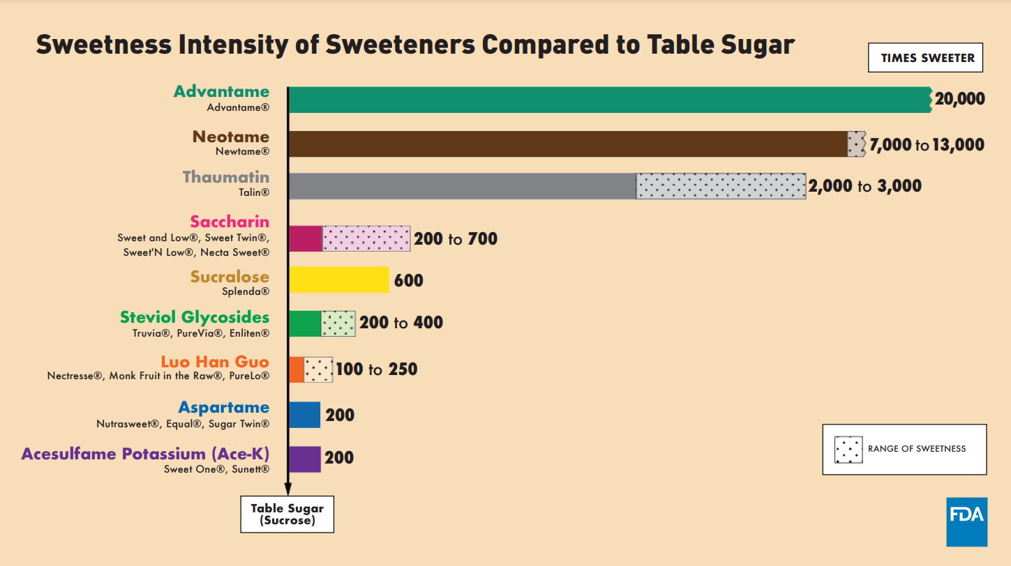

Slide 33
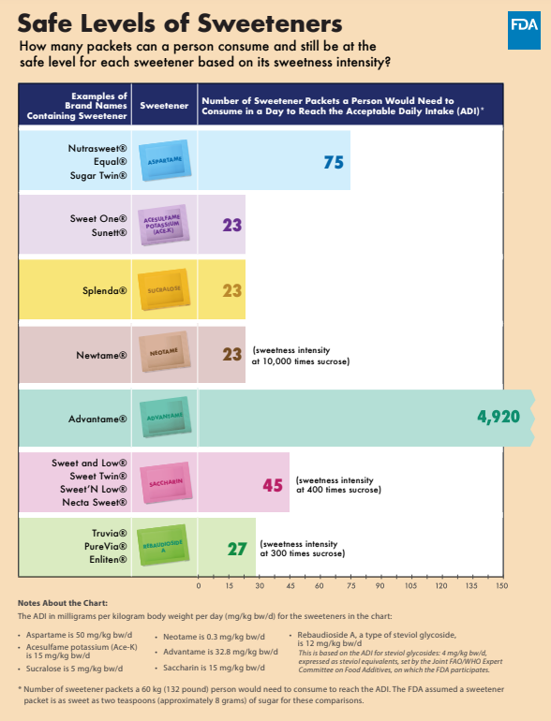
Acceptable Daily Intake (ADI)
“An ADI is the amount of a substance considered safe to consume each day over the course of a person’s lifetime. The ADI is typically based on evaluating toxicological studies to determine the highest appropriate experimental exposure dose level in animal studies that was shown to cause no adverse effect, multiplied by an appropriate safety factor.” -FDA
The ADI is based off a person’s body weight and the chart to the right is for a 132 pound person.
Aspartame is the sweetener used in diet soda. A 40 pound child would need to consume four 12 ounce diet sodas every day to reach the ADI set for aspartame.

Slide 34
Claims on artificial sweeteners
FDA: “Based on the available scientific evidence, sweeteners authorized by the FDA are safe for the general population under certain conditions of use”
WHO: “The World Health Organization (WHO) has released a new guideline on non-sugar sweeteners (NSS), which recommends against the use of NSS to control body weight or reduce the risk of noncommunicable diseases.”
National Cancer Institute: Because some studies have suggested that artificial sweeteners are associated with obesity, and obesity is in turn linked to at least 13 types of cancer, the NutriNet-Santé investigators also looked for associations between artificial sweetener intake and obesity-related cancers as a group. The risk of obesity-related cancers was slightly higher in people who consumed higher amounts of all artificial sweeteners than in those who did not consume artificial sweeteners. By contrast, an Australian cohort study found no association between artificially sweetened beverage intake and the risk of obesity-related cancers.”
American Diabetes Association: “These sweeteners have virtually no calories, although their effectiveness for long term weight loss isn’t clear. Sugar substitutes generally don’t raise blood glucose levels.”

Slide 35


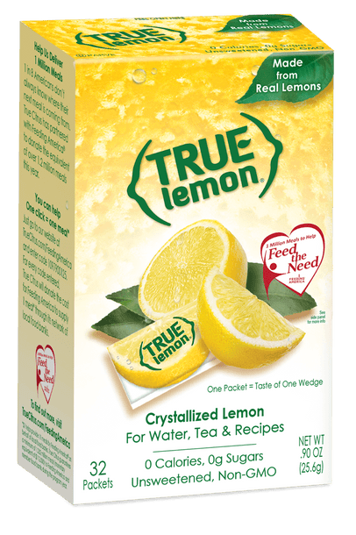
Beverage options to replace added sugar and non-nutritive sweeteners
Infused water
Hint juice box
Honest juice box (8 grams sugar/6 oz)
Seltzer water
True citrus packets: true lemon, true lime, true orange
Some herbal teas (mint, chamomile)

Slide 36
Take away on artificial sweeteners
Ultimately it is up to you! Both sugar and artificial sweeteners should be consumed in moderation
Most foods that contain these sugar or artificial sweeteners do not provide any nutritional benefit but rather fill kids up with empty calories
Eating and drinking excessively sweet things makes our body want more sweet things. Try offering a wide variety of fruits for kids to satisfy sweet cravings rather than offering up these empty calorie sugar foods and drinks!

Slide 37
Language around food and diet culture
The way we talk about food as a family can significantly impact our children’s relationship with food as they grow up
  Avoid labeling foods “good” and “bad”; instead talk about how certain foods can give us more energy or make us stronger while other foods may leave us feeling tired and sluggish
  Avoid rewarding behavior/performance with food; instead think of non food rewards to offer as a family like game night or movie night
  Avoid offering dessert ONLY if they finish a meal
  Avoid talking about your own body negatively

Slide 38
Eating disorders in children and teens
1 in 7 men and 1 in 5 women experience an eating disorder by age 40, and in 95% of those cases the disorder begins by age 25. Many can affect children and teens.
Eating disorders have been on the rise in children and teens during the pandemic
  Anorexia nervosa: characterized by an extreme fear of gaining weight
    Restrictive form: limit what and how much you eat
    Binge-purge form: eat large amount at once and try to get rid of extra calories through vomiting, laxatives, diuretics or excessive exercise
  Bulimia nervosa: binging and purging without limiting what and how much a person eats
  Binge eating: people binge eat but don’t purge or restrict (most common eating disorder in the US)
  Avoidant restrictive food intake disorder: limit the amount or type of food they eat but not because they are worried about their weight (most common in childhood)

Slide 39
What parents need to know: signs and symptoms of eating disorders
Changes in what, when and how much they eat
Being restrictive or regimented about their eating
Unusual weight fluctuations
Expressing unhappiness with their body or their weight
Exercising much more than usual
Spending a lot of time in the bathroom
If you have concerns, talk to your child and talk to your doctor.

Slide 40
Resources
Recipes
Other
Ambitiouskitchen.com
Theleangreenbean.com
Hummusapien.com
Skinnytaste.com
Feeding littles course
  Infant
  Toddler and kid (1-10 years old)
Eating disorder program
  The Emily Program
Baby Led Weaning Made Easy podcast by Katie Ferraro, RD

